Slide 1
Bonbons Sans Frontieres Database
Eric Grant

Slide 2
Bonbons Sans Frontieres (BSF)
BSF is a non-profit organization that provides candy to those without access to reliable candy sources.
They are active in covering disasters with massive candy relief packages.
They also take requests from users to determine prime targets for candy aid.

Slide 3
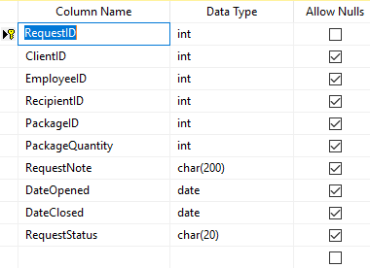
Request

Slide 4
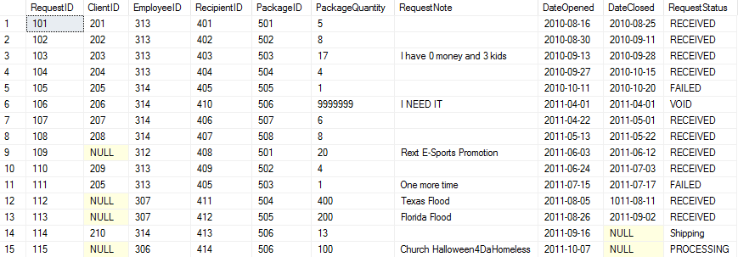
Request

Slide 5
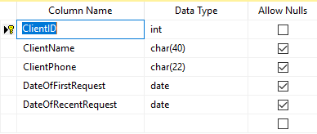
Client

Slide 6
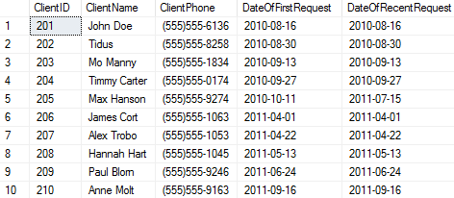
Client
Every user that made a request via a web form.

Slide 7
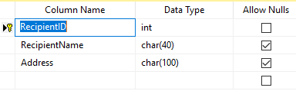
Recipient

Slide 8
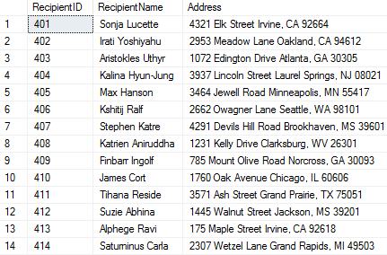
Recipient

Slide 9
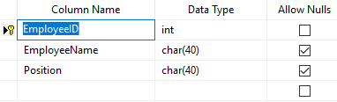
Employee

Slide 10
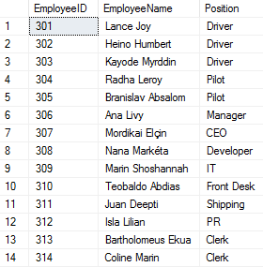
Employee

Slide 11
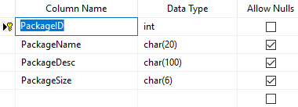
Package

Slide 12
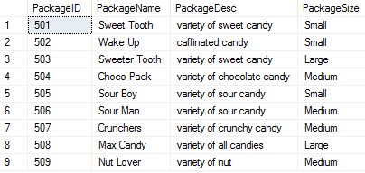
Package

Slide 13
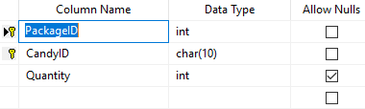
PackageManifest

Slide 14
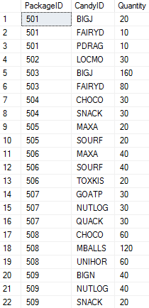
PackageManifest

Slide 15
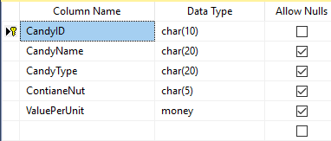
Candy

Slide 16
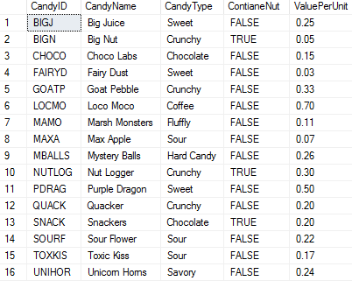
Candy

Slide 17
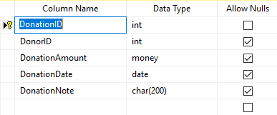
Donation

Slide 18
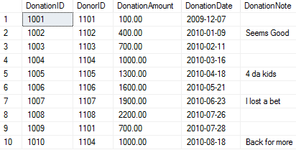
Donation

Slide 19
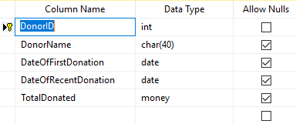
Donor

Slide 20
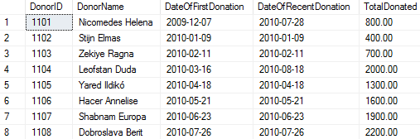
Donor

Slide 21
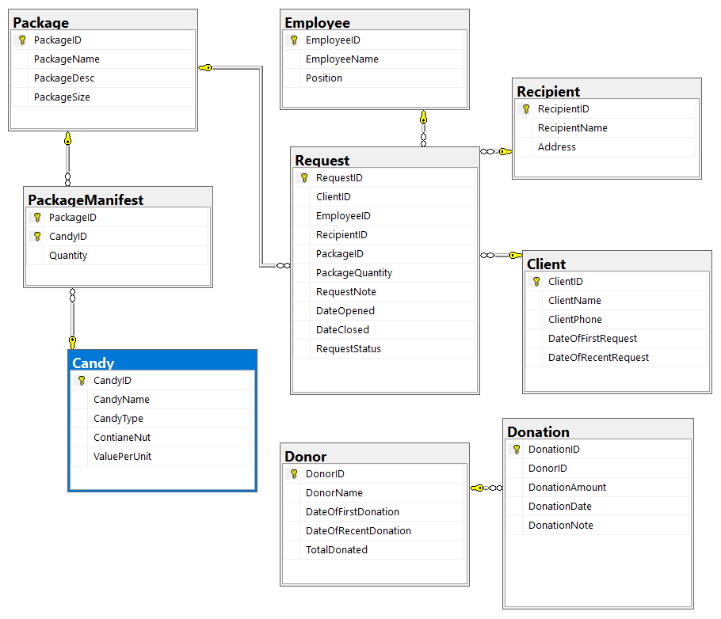
Database Diagram

Slide 22


View: repeat-donors

Slide 23
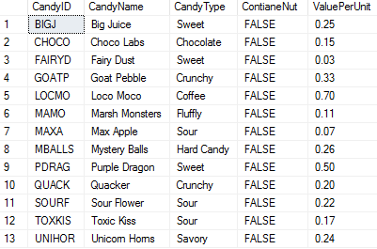

View:
nut_free_candy

Slide 24

Stored Procedure: FindStatus
EXEC dbo.FindStatus 'FAILED'

Slide 25
Design Decisions
Package manifest linking table with composite key.
Split donations and requests.
Split clients and recipients.

Slide 26
Front End
Clients can make requests via the BSF website to have candy packages delivered to those in need.
The BSF website also facilitates the donation of funds directly to BSF.
BSF Employees can also directly manipulate the database to record packages sent and manage information.

Slide 27
Room For Improvement
Stored procedures that alter the database.
Synched client and recipient ID.
More information.

Slide 28
What I learned
The difference between views, functions, and stored procedures.
How to properly link tables primary key to foreign key.

Slide 29
Questions?

